Slide 1
Project SciKey

Slide 2
Opening
Notes:
Every day, thousands of scientific papers are published… and most of that knowledge gets buried. Not because the science is wrong, but because the information is disorganized.
When we started working with the HAL database, I realized something important: researchers are producing knowledge faster than we can structure it. And without structure, knowledge gets lost. That’s where this project was born. SciKey is our attempt to close that gap and help machines understand a scientific language that humans write in a thousand different ways.”

Slide 3
Problem
Scientific keywords are supposed to describe the core concepts of a paper… but in reality, they behave like confusing concepts.
One word can mean five completely different things depending on the discipline.

Slide 4
Project Context
This project uses data from HAL, a large French scientific repository.
Our goal was not only to extract keywords from HAL, but to map each keyword to the correct Wikidata QID.
Why Wikidata?
Because it’s structured, multilingual, and concept-based.
If we can anchor each scientific keyword to the right QID, then we can:
Improve search
Build domain networks
Enable cross-disciplinary analysis
And support downstream machine learning tasks
So the objective is about creating a bridge between unstructured scientific language and structured knowledge graphs.

Slide 6
Solution
High-Level Architecture
SciKey works as a multi-stage pipeline:
  Keyword extraction
  Enrichment: fetching labels, aliases, descriptions, P31, P279 paths
  Scoring: combining all textual and structural signals
  Ranking QIDs
  Selecting the best match
  Exporting results to MySQL and Neo4j for visualization
Each stage contributes to a more reliable understanding of the keyword.

Slide 7
Key Technical Components
Now the core of the system is the scoring engine, the part that decides which QID is the most accurate.
We designed it by combining several signals:
  Label similarity: fuzzy match between the keyword and the QID label
  Alias boost: especially helpful when a synonym is exact
  Context similarity: matching the keyword with abstract, title, and domain context
  P31 and P279 signals: instance-of and subclass-of help ensure semantic correctness
  Sitelinks weight: higher sitelinks = stronger, well-established concept
We also implemented debug tools such as debug_scores.csv that record every step of the scoring, allowing me to evaluate and refine each weight

Slide 8
Generalization
High-Level Architecture
SciKey isn’t hardcoded for chemistry or biology.
The engine was designed to be domain-agnostic.
The same logic works for:
  chemistry
  Civil engineering
  Political science
  Marketing
This makes the system scalable for future repositories.

Slide 9
Results
High-Level Architecture

Slide 10
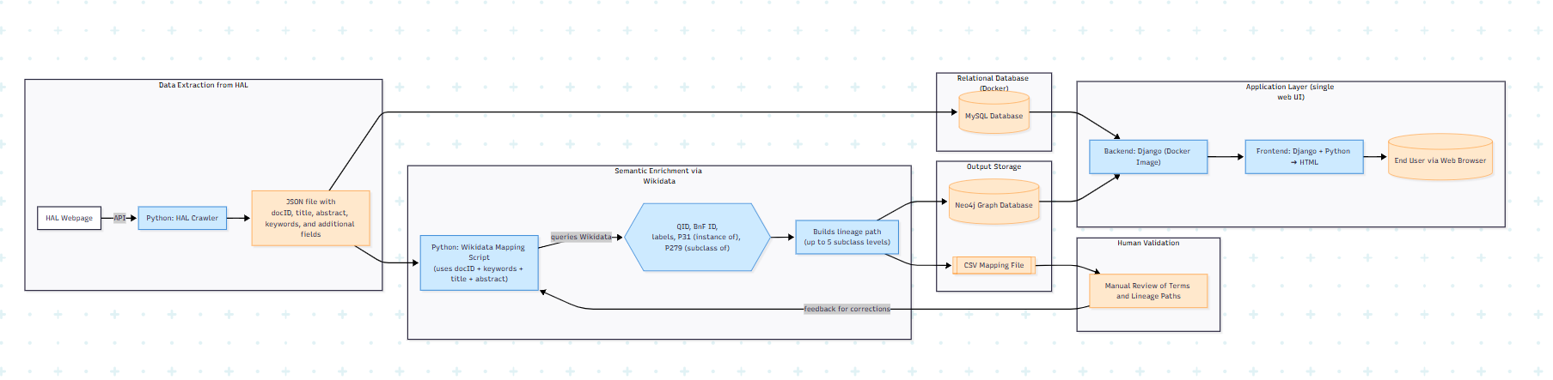
End-to-End Data Integration and Semantic Mapping Architecture

Slide 11
End-to-End Data Integration and Semantic Mapping Architecture

Slide 12
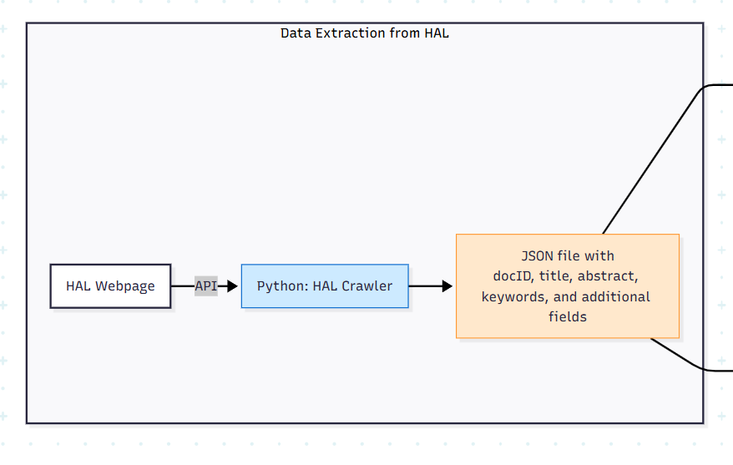
Data Extraction from HAL

Slide 13
End-to-End Data Integration and Semantic Mapping Architecture

Slide 14
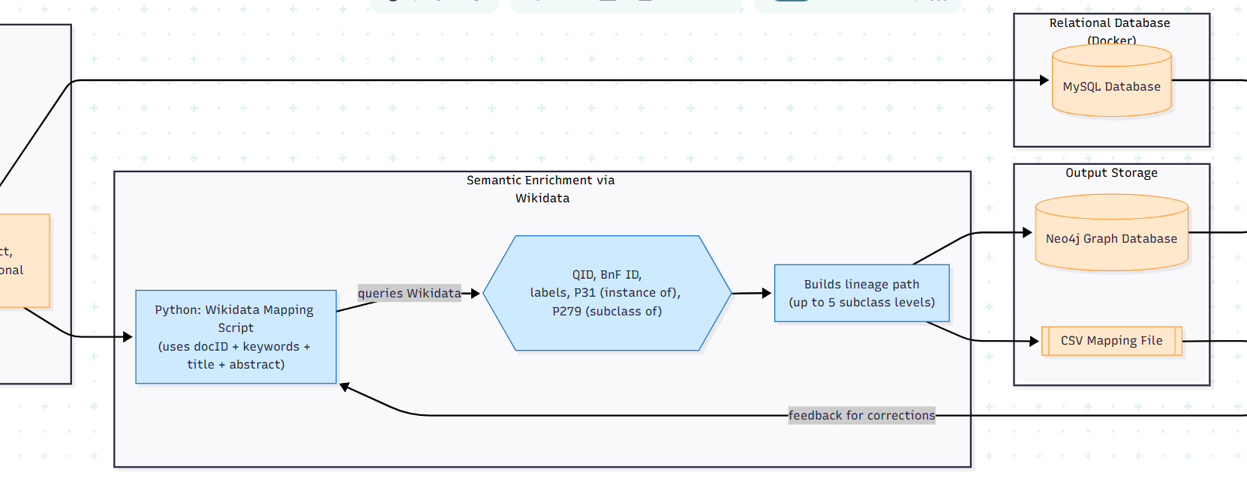
Wikidata

Slide 15
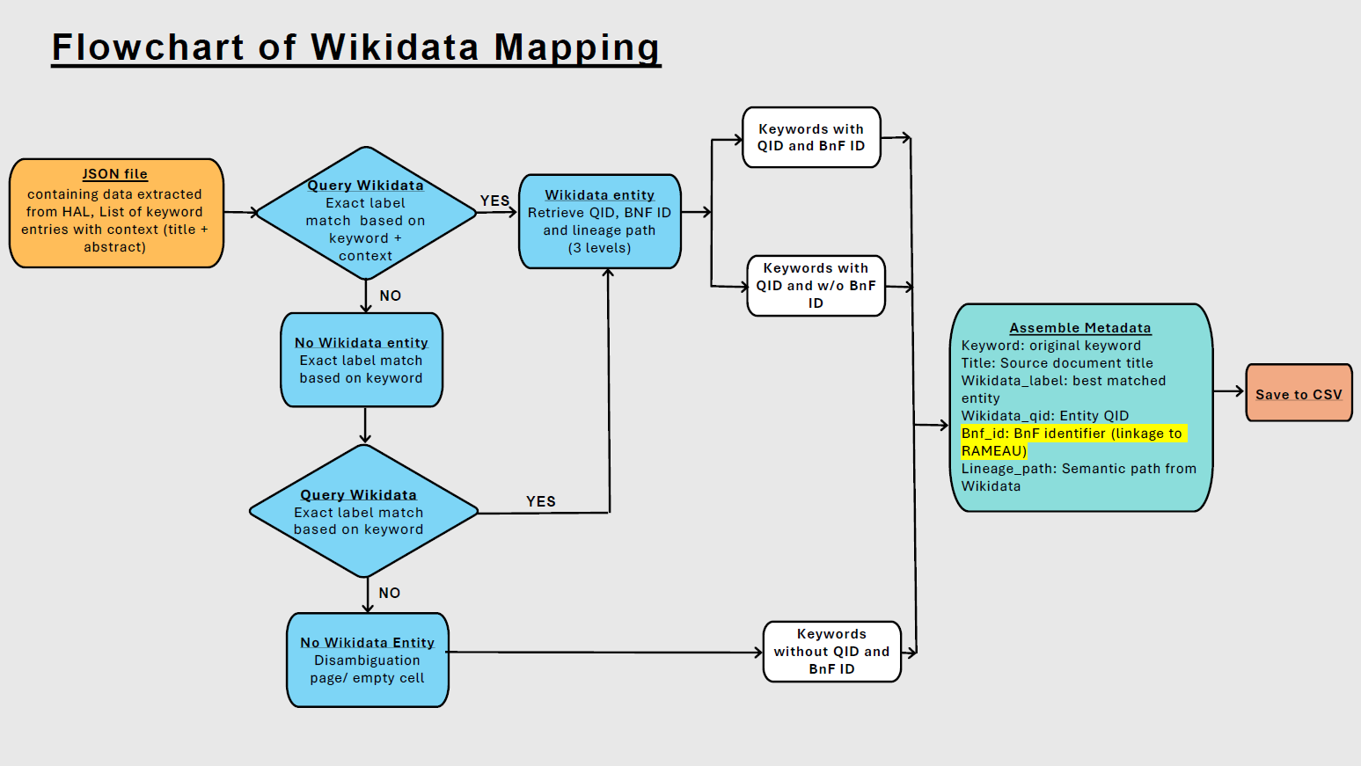
Final documentation

Slide 16
End-to-End Data Integration and Semantic Mapping Architecture

Slide 17
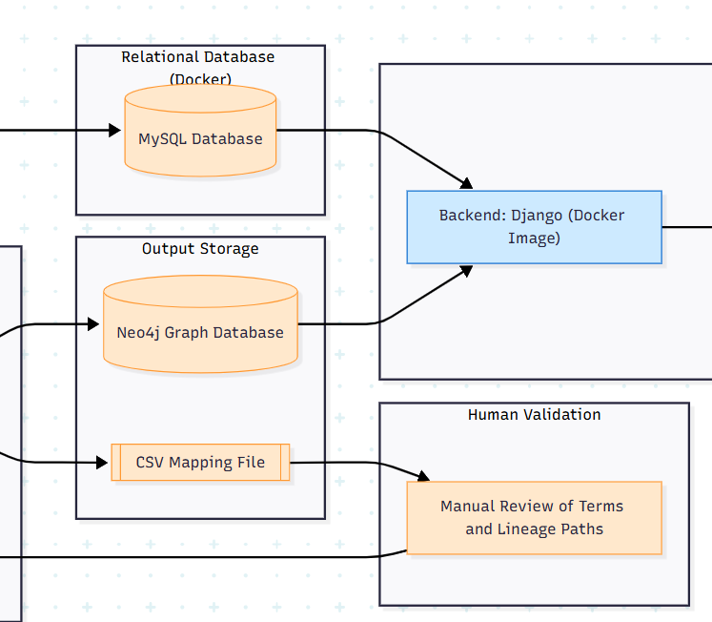
Human Validation and Neo4j + MySQL

Slide 18
End-to-End Data Integration and Semantic Mapping Architecture

Slide 19
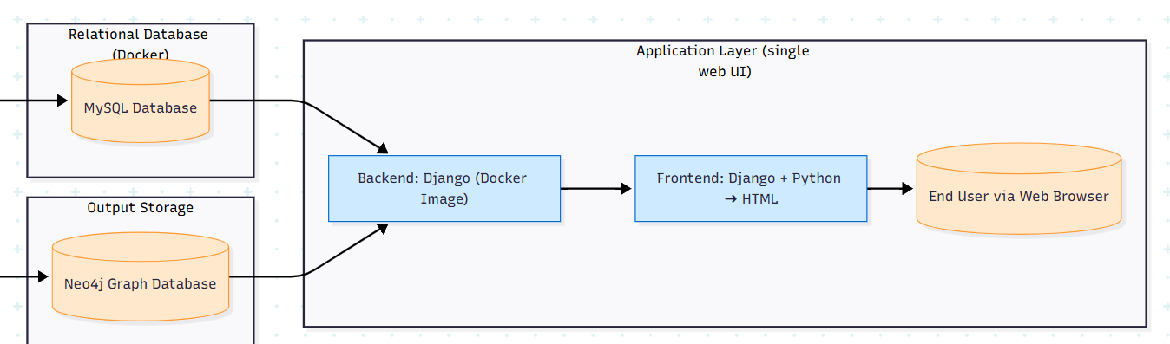
Application Layer

